Slide 1

Classification and Detection with Convolutional Neural Networks Presentation
Shanshan Jiang
sjiang97@gatech.edu

Slide 2
Presentation YouTube Link: 1. https://youtu.be/T8JR1SBmhGs
https://youtu.be/MUVcTpa0LkY
Demo Youtube Link: 1. https://youtu.be/_iE2LqsT09s
2. https://youtu.be/4AlwVn8JX5Q

Slide 3
1. Introduction
1. The convolutional neural network (CNN) has achieved great success in many computer vision tasks.
2. The MSER algorithm to extract patches.
3. Borrows the structure of VGG-16 with some changes.
4. Residual block.
5. Digital dataset SVHN combined with non-digital dataset .
Notes:
And here I am showing that what I have already done in my project.

Slide 4
2. Previous Work
1. Lee, C. Y., Gallagher, P. W., & Tu, Z. (2016, May). Generalizing pooling functions in convolutional neural networks: Mixed, gated, and tree. In Artificial Intelligence and Statistics
2. Liao, Z., & Carneiro, G. (2015). Competitive multi-scale convolution.
3. Liang, M., & Hu, X. (2015). Recurrent convolutional neural network for object recognition.
Notes:
In this part, I am showing that I have already done some research and I listed that best top three that related to field of CNN.

Slide 5
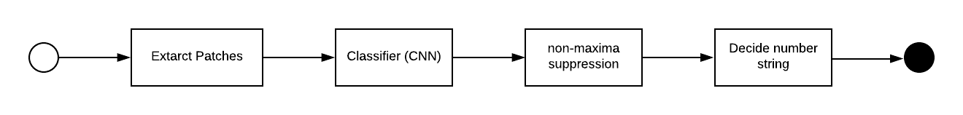
3. Algorithms

Slide 6

3.1 Extract Patches
Maximally Stable Extremal Regions (MSER)

Slide 7
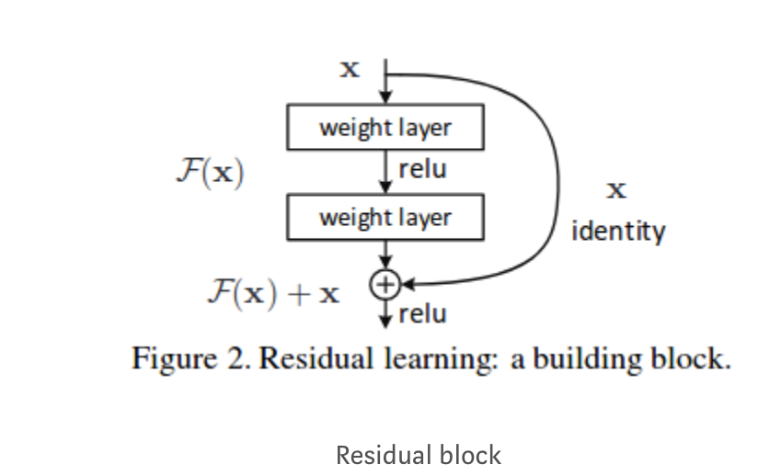
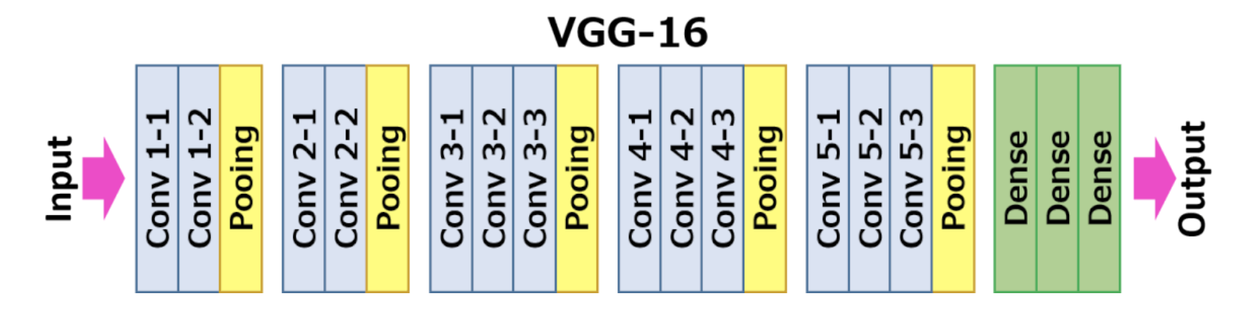
3.2 Classifier(Convolution Neural Networks)
Convolution neural networks;
VGG-16 Structure;
The proposed Network Structure. what I made in my project is I changed the Conv layer to residual block showing figure right. The research is showing that the ResNet outperforms than others because it is easy to push the residuals to zero (F(x) = 0). In a simple language, using a bunch of nonlinear CNN layers as functions, it is able to directly derive solutions like F (x) = 0 instead of F (x) = x.

Slide 8
3.3 Non-maxima Suppression
1. What is NMS
2. Suppression in my project:
The suppression process base on two aspects: First, it has to make sure that multiple box point at the same object; Second, it also has to make sure that the boxes are close enough, which is by calculating the average.

Slide 9
4. Results
4.1 Network Training
4.2 Comparison
4.3 Discussion

Slide 10
4.1 Network Training
Dataset:
SVHN & non-numeric data.
Data Augmentation:
Scale invariance, Location invariance, Font invariance, Pose invariance, Lighting invariance, and Noise invariance.
Training Details:
GPU: NVIDIA, TITAN;
Learning rate: 0.0001;
Batch site: 1024;
Epochs: 800;

Slide 11
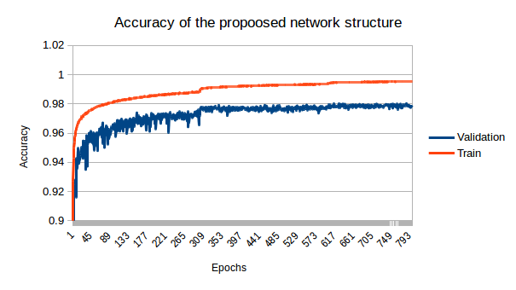
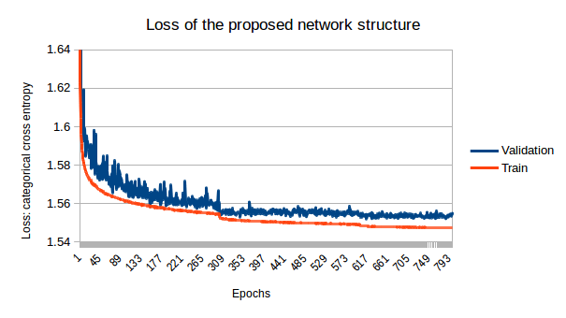
4.2 Comparison
Proposed Network Structure:
Accuracy & Loss
Training result: 98%;
Test result: 97.4%

Slide 12
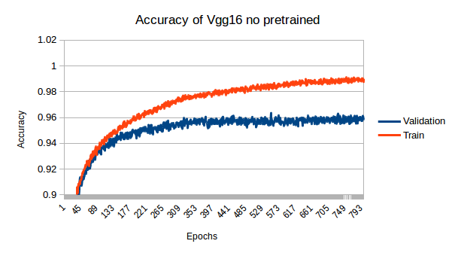
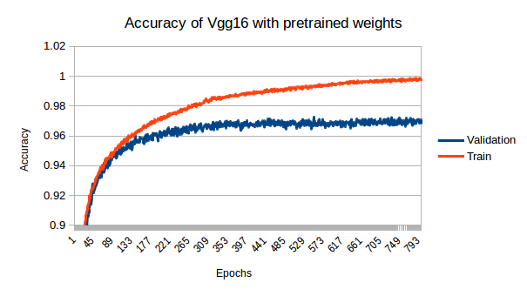
VGG-16: Pre-Trained Weights & without Pre-trained Weights
Training results:
Pre-trained weights: 98.9%;
No pre-trained weights: 96.7%
Test results:
Pre-trained weights: 98%;
No pre-trained weights: 96.1%

Slide 13
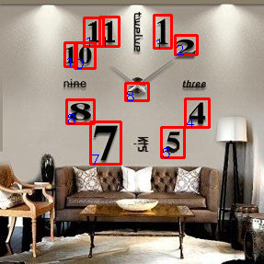
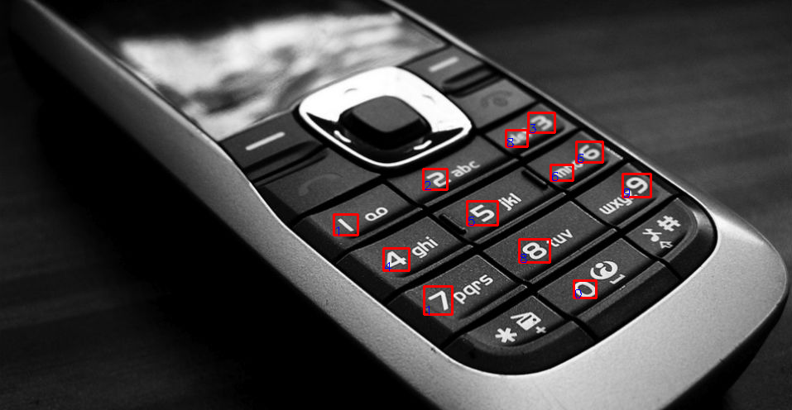
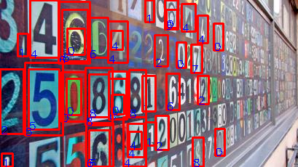
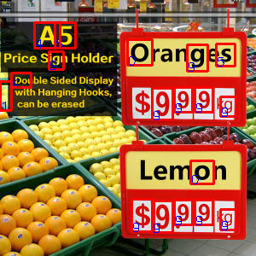
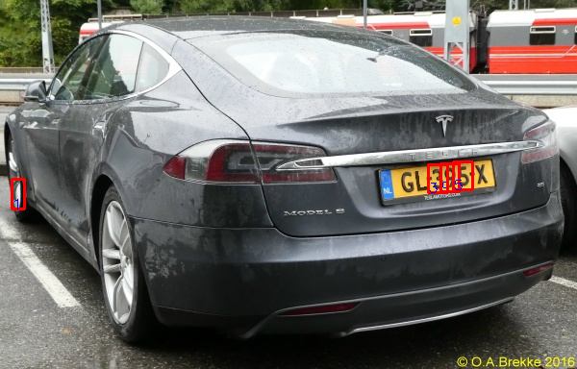
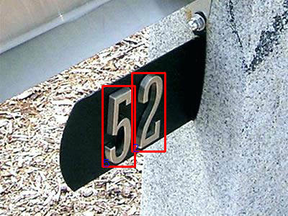
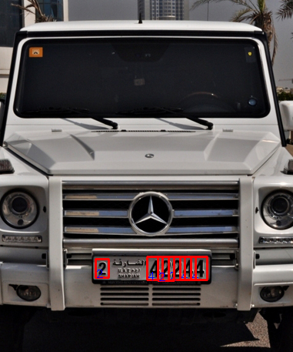
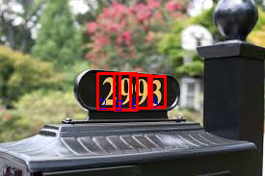
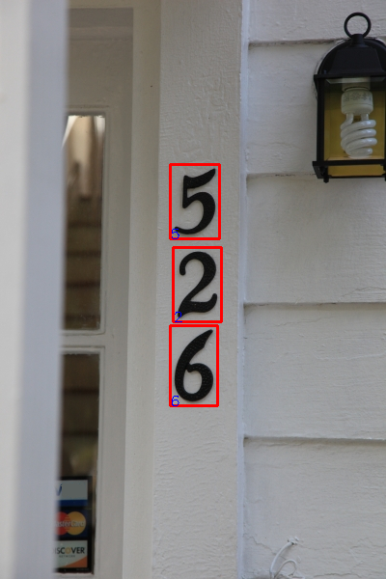
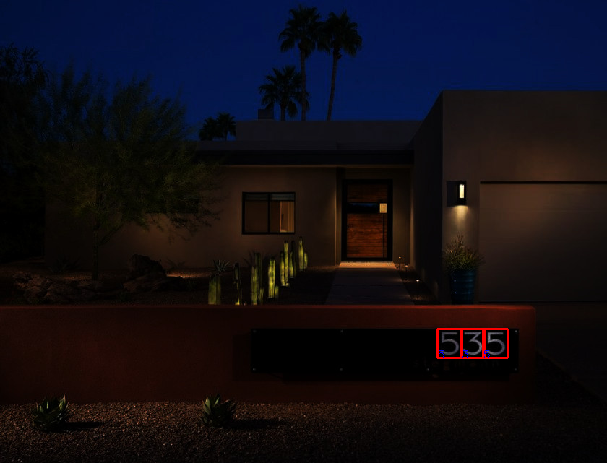
4.3 Discussion
1. The number in some images cannot be recognized completely.
2. The number in some images can be recognized fully.
Notes:
In my work, I found that sometimes, the numbers in some images is hard to recognize, but some are easy.

Slide 14
5. Conclusion
Comparison with the state of the art.
How to improve my work?
Notes:
1.69%
Something can be improve in my work:
1, Increase the number of negative case;
2. Adding datasets to train.
3. Find more deep structure.

Slide 15

6. reference
1. Karpathy, A. (n.d.). CS231n Convolutional Neural Networks for Visual Recognition. Retrieved April 15, 2019, from http://cs231n.github.io/convolutional-networks/
2. Convolutional neural network. (2019, April 09). Retrieved April 16, 2019, from https://en.wikipedia.org/wiki/Convolutional_neural_network
3. Lee, C. Y., Gallagher, P. W., & Tu, Z. (2016, May). Generalizing pooling functions in convolutional neural networks: Mixed, gated, and tree. In Artificial Intelligence and Statistics (pp. 464-472).
4. Maximally stable extremal regions. (2019, February 19). Retrieved April 19, 2019, from https://en.wikipedia.org/wiki/Maximally_stable_extremal_regions
5. VGG16 - Convolutional Network for Classification and Detection. (2018, November 21). Retrieved April 19, 2019, from https://neurohive.io/en/popular-networks/vgg16/
6. Jay, P., & Jay, P. (2018, February 07). Understanding and Implementing Architectures of ResNet and ResNeXt for state-of-the-art Image... Retrieved April 19, 2019, from https://medium.com/@14prakash/understanding-and-implementing-architectures-of-resnet-and-resnext-for-state-of-the-art-image-cf51669e1624
7. Liao, Z., & Carneiro, G. (2015). Competitive multi-scale convolution. arXiv preprint arXiv:1511.05635.
8. Liang, M., & Hu, X. (2015). Recurrent convolutional neural network for object recognition. In Proceedings of the IEEE conference on computer vision and pattern recognition (pp. 3367-3375).

Slide 16
The End!
Thanks for your reading!

